Slide 1

Estimation
1 2 3 4 5 6 7 8 9 10

Slide 2
Estimation.
You are about to test your estimation skills!
You need to estimate how many toys are on each slide.
You will see them for a few seconds before they disappear!
You can then make your estimation.

Slide 3
Are you ready for your first estimation?
Press the arrow to start the challenge.

Slide 4
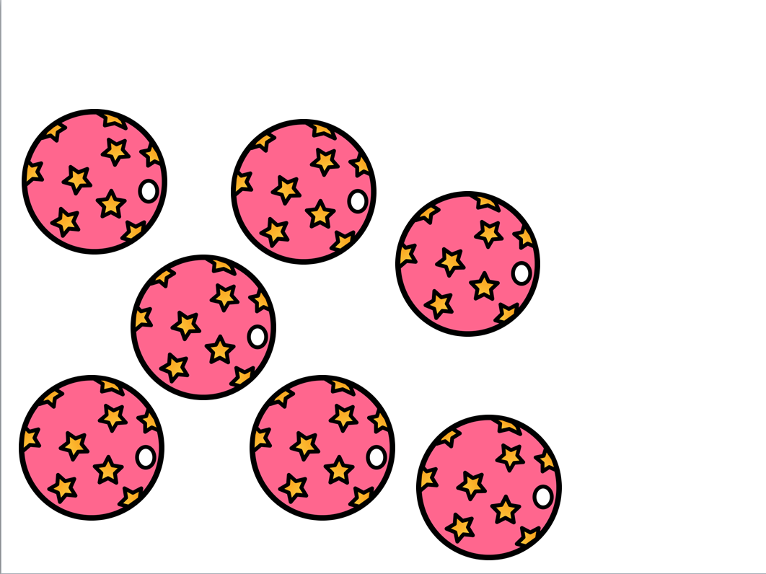
Estimate how many balls are here.
5
6
7

Slide 5
Estimate how many balls are here.
5
6
7

Slide 6
Estimate how many balls are here.
5
6
7

Slide 7
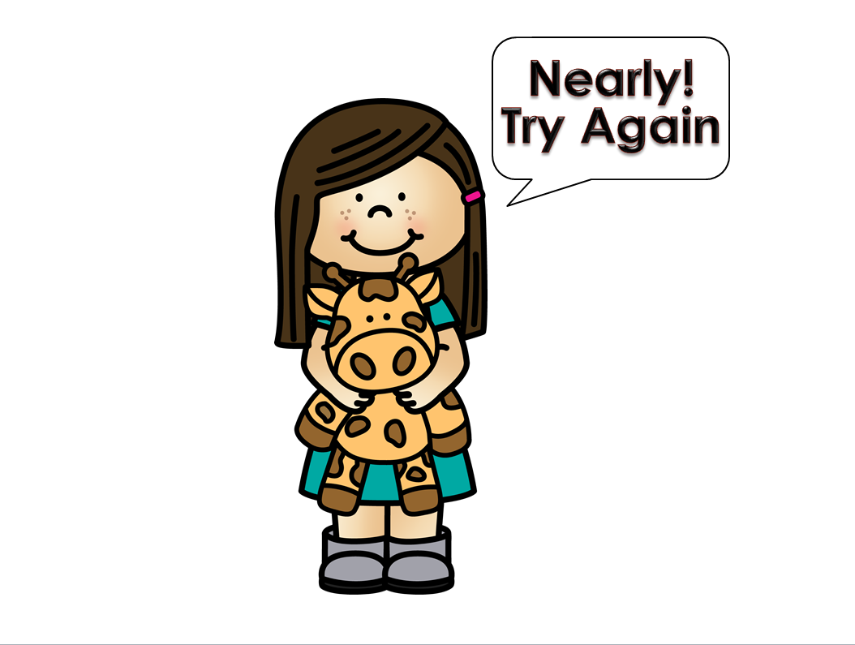

Slide 9
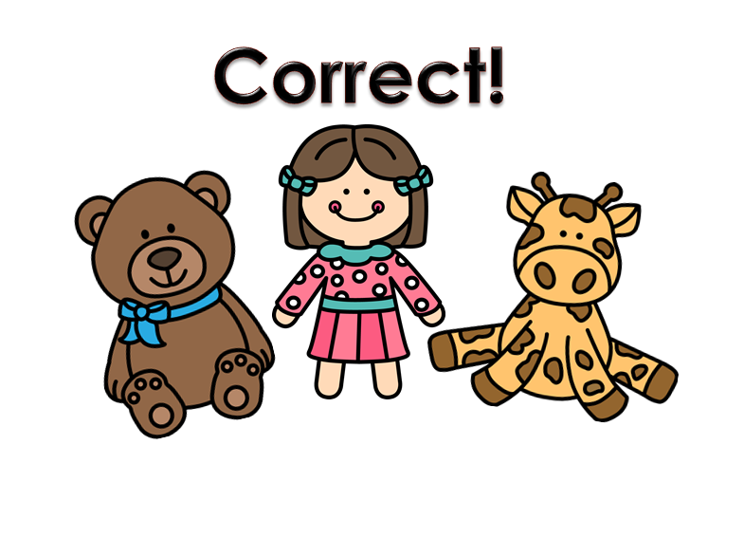
Play again

Slide 10
Are you ready for your next estimation?
Press the arrow to start the challenge

Slide 11
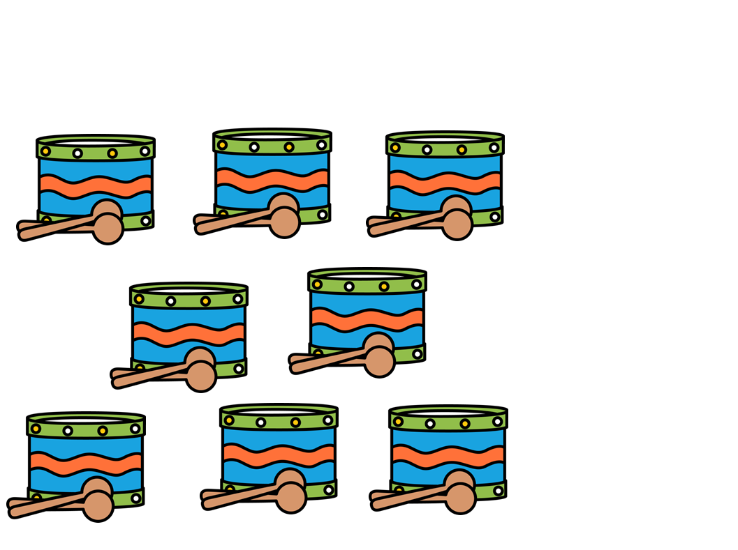
Estimate how many drums are here.
7
8
9

Slide 12
Estimate how many drums are here.
7
8
9

Slide 13
Estimate how many drums are here.
7
8
9

Slide 16
Play again

Slide 17
Are you ready for your next estimation?
Press the arrow to start the challenge

Slide 18
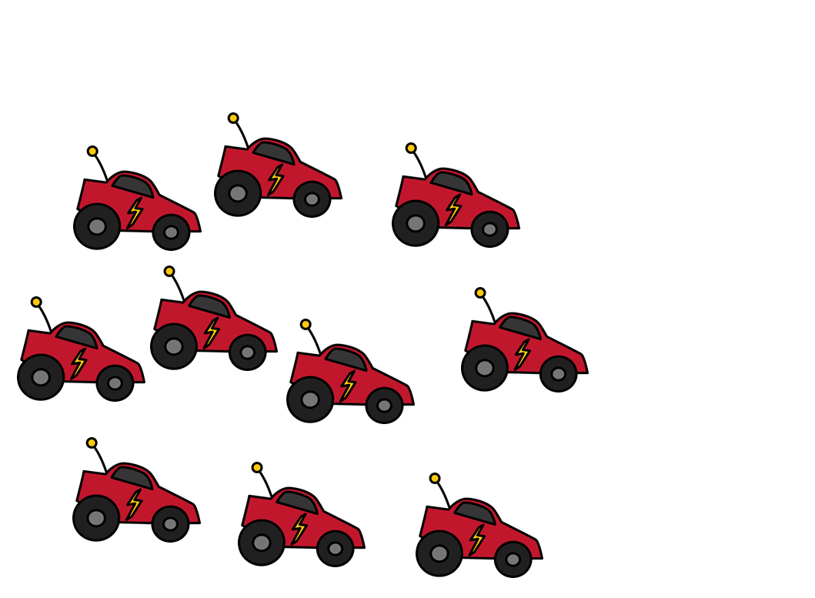
Estimate how many cars are here.
8
9
10

Slide 19
Estimate how many cars are here.
8
9
10

Slide 20
Estimate how many cars are here.
8
9
10

Slide 23
Well done!

Slide 24
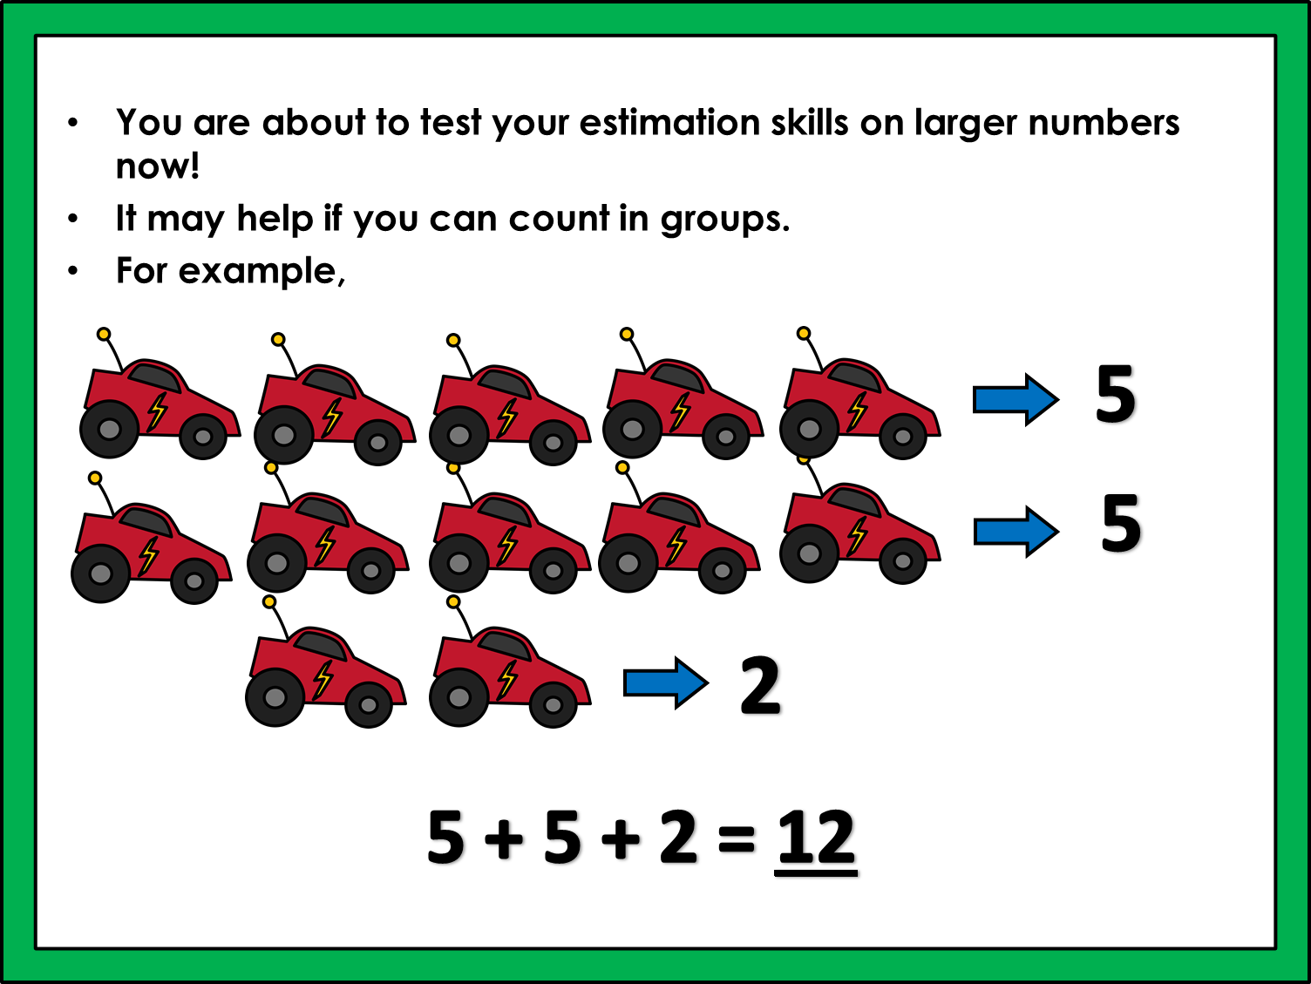

Slide 25
Are you ready for your next estimation?
Just like before, you will need to estimate how many toys are on each slide.
You will see them for a few seconds before they disappear!
You can then make your estimation.
Press the arrow to start the challenge.

Slide 26

Estimate how many airplanes are here.
11
12
13

Slide 27
Estimate how many airplanes are here.
11
12
13

Slide 28
Estimate how many airplanes are here.
11
12
13

Slide 29
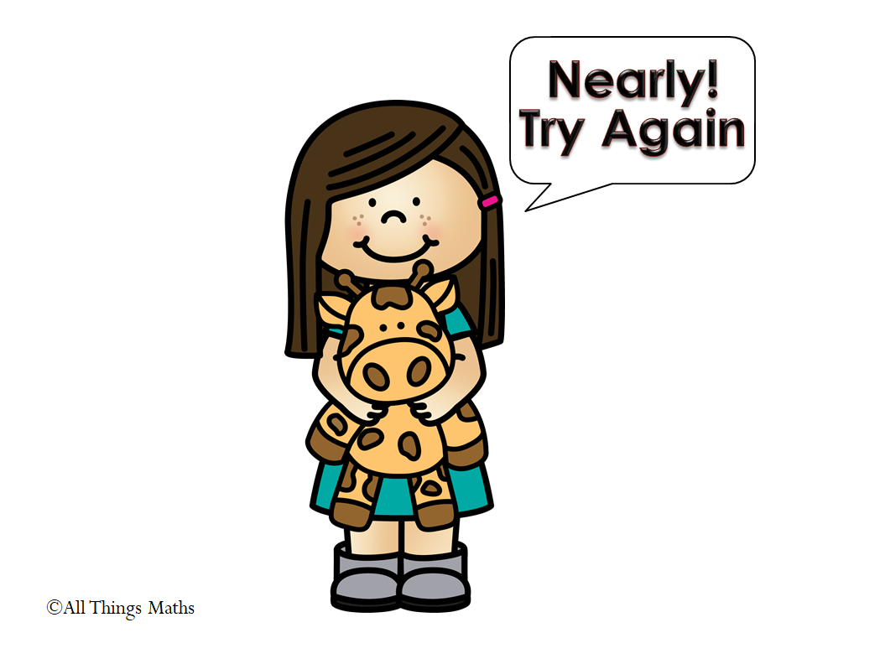

Slide 31
Play again

Slide 32
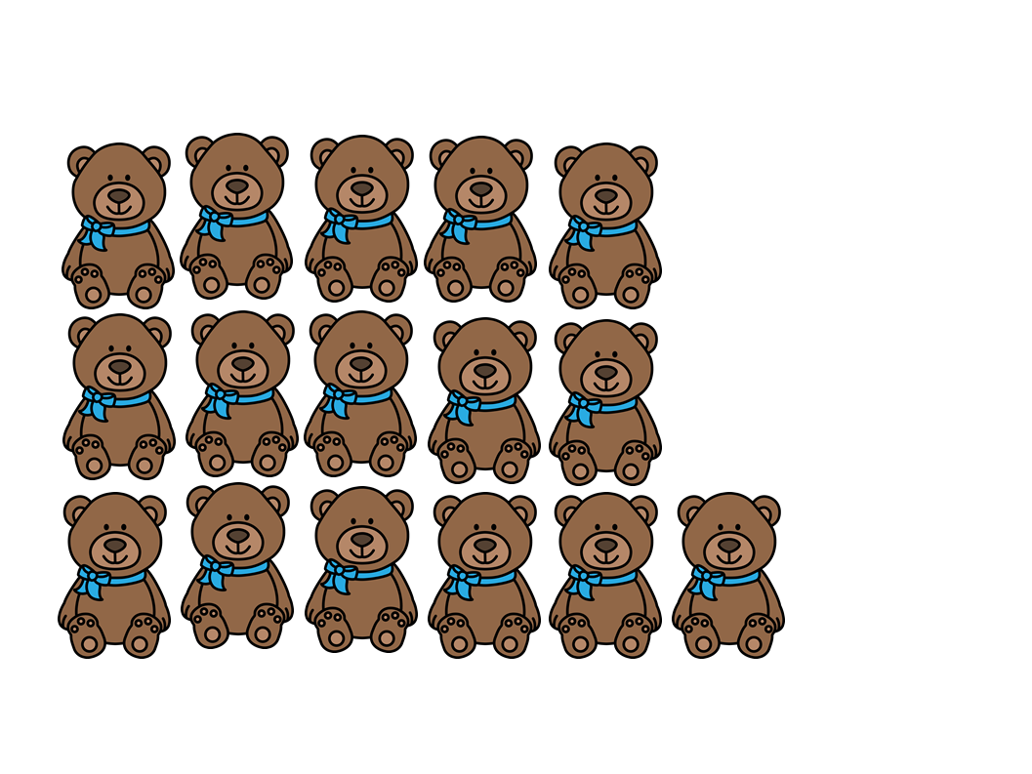
Estimate how many teddy bears are here.
16
17
18

Slide 33
Estimate how many teddy bears are here.
16
17
18

Slide 34
Estimate how many teddy bears are here.
16
17
18

Slide 37
Well done!

Slide 38
Why not try your own estimation activities?
Suggestions
Pick up a handful of counters or cubes. Take a quick look before estimating how many you are holding. Count them. Were you right?
Ask a friend to put cubes/sweets/small toys into a clear container. Estimate how many are in the container before counting them.

Slide 39


Estimation.
Thank you for downloading this resource.
With many thanks and credit for the great clipart from:
https://www.teacherspayteachers.com/Store/Whimsy-Clips
If you have any further questions, please do not hesitate to contact me:
info@allthingsmaths.co.uk

